Slide 1

CMP1101: DIODE APPLICATIONS

Slide 2
DIODE APPLICATIONS
Diodes of 50 Hz to 50 kHz frequencies:
They are never intentionally operated in the breakdown region, because . . . . . ??
But some special diodes are specifically designed to overcome such shortcomings.
Zener diodes
Schottky diodes
Tunnel diodes
Optoelectronics
Bidirectional breakdown diodes
Varactor
Rectifier diodes

Slide 3
Zener Diode
Sometimes called the breakdown diode, the Zener diode is constructed from a highly doped p-n junction.
Designed to operate in the forward and also in the reverse breakdown region (Zener region) beyond the peak inverse voltage rating of normal diodes.
Reverse breakdown voltage is called the Zener or reference voltage, V_{z} (2.4 V – 200 V)
The Zener effect causes a “soft” breakdown while the avalanche effect causes a sharper turnover.
Both effects are used in the Zener diode.
The manufacturer predetermines the Zener and avalanche voltages.

Slide 4
Zener Diode Cont.
For V_{z} < 6V, the physical breakdown phenomenon is called the Zener breakdown characterized with high electric field.
It has a negative temperature coefficient.
For V_{Z} > 6V, the physical breakdown phenomenon is called the avalanche breakdown characterized with high kinetic energy.
It has a negative temperature coefficient.
For V_{Z} ≈ 6V, the breakdown voltage has nearly zero temperature coefficient and a nearly vertical i-v characteristic in the breakdown region.
Essentially this means that there exists a very small resistance R_{Z}
For near -6V, the temperature coefficient of a Zener diode changes from negative to positive.

Slide 5
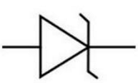
Zener Diode Cont.
The Zener diode is the backbone of voltage regulators (circuits that hold the load voltage constant despite large changes in line voltage and load resistance).
When used as a regulator, the Zener diode is reverse biased so that it operates in the breakdown region with a highly stable Zener voltage.
The power Zener diode is called an avalanche diode. It can withstand kilovolts voltages and currents of thousands of amperes.
When intended for use as a Zener
diode, the diode symbol becomes

Slide 6
Schottky or Reverse Diode
As the frequency increases, the ordinary diode reaches where it can not turn off fast enough to prevent noticeable current during the reverse half cycle.
A special purpose high frequency diode with no depletion layer, no pn junction and extremely short recovery time is used.
Acts much faster than the rectifier diode
Has a low breakdown voltage.

Slide 7
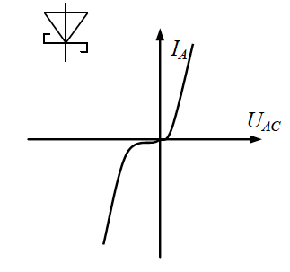
Schottky or Reverse Diode
The operation of a Schottky diode is based on the concept that water in different materials have different absolute potential energies and the potential energy of electrons in materials is lower than the potential energy of free electrons.
If an n-type semiconductor is in contact with a metal, the electrons of which have a lower potential energy than those of the semiconductor material.
As a result of the ensuing attractive flux, the metal will become negatively while the semiconductor will be positively charged.
This way, a metal semiconductor junction is formed where the metal replaces the p-type side of the p-n junction.

Slide 8
Homework 2 Due: September 14, 2018 at Noon
For the diodes listed below, discuss their operation highlighting the diode’s region of operation, mode of operation showing the technical specifications and the diode applications in electronics:
Tunnel diodes
Photoelectronics
Bidirectional breakdown diodes
Varactors
Rectifier diodes

Slide 9
Cover Page

